Slide 1
Mule ESB
Integration platform provided by MuleSoft

Slide 2
What is Mule ESB?
Mule ESB is a lightweight and highly scalable Java-based enterprise service bus (ESB) and integration platform provided by MuleSoft.
Mule ESB allows the developer to connect applications easily and quickly.
Regardless of various technologies used by applications, Mule ESB enables easy integration of applications, enabling them to exchange data.

Slide 3
Why to create Mule Project?
to make things simpler for the programmers,
the need of lightweight and modular solution that could scale from an application-level messaging framework to an enterprise-wide highly distributable framework.
Mule ESB is designed as an event-driven as well as programmatic framework. It is event-driven because it is combined with unified representation of messages and can be expandable with pluggable modules.
It is programmatic because programmers can easily implant some additional behaviors such as specific message processing or custom data transformation.

Slide 4
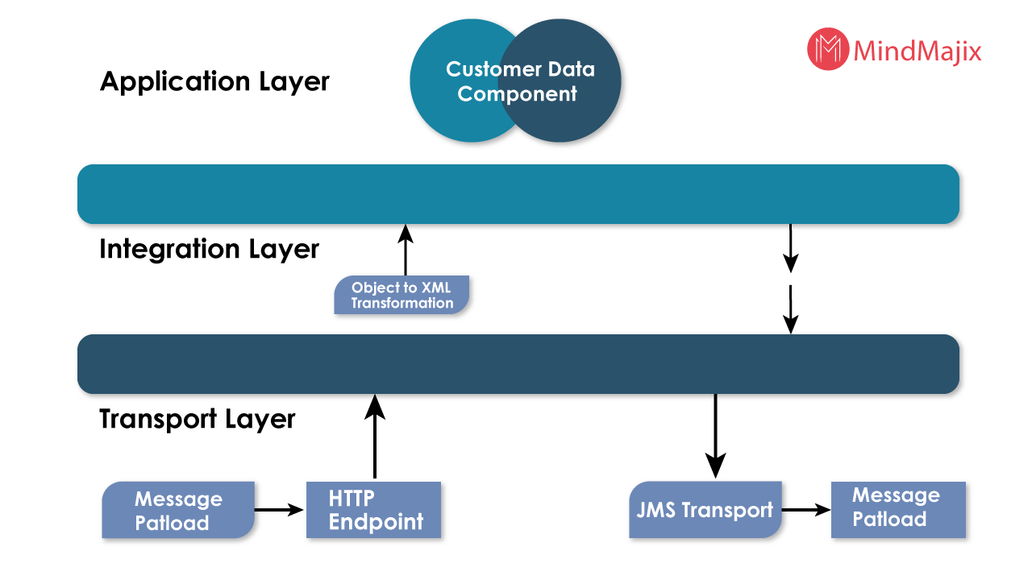
Architecture

Slide 5
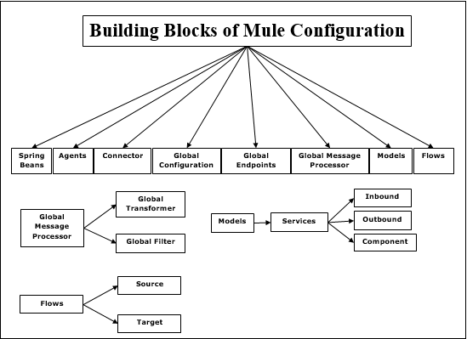
Building Blocks

Slide 6
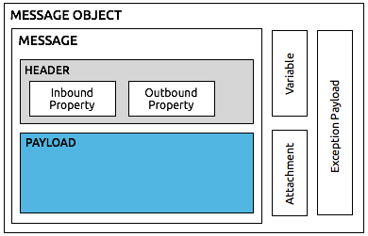
Mule Message Structure

Slide 7
Let’s create a first Application using Mule

